Slide 1
Business continuity and disaster recovery
Notes:
Information in this document, including URL and other Internet Web site references, is subject to change without notice. Unless otherwise noted, the example companies, organizations, products, domain names, e-mail addresses, logos, people, places, and events depicted herein are fictitious, and no association with any real company, organization, product, domain name, e-mail address, logo, person, place or event is intended or should be inferred. Complying with all applicable copyright laws is the responsibility of the user. Without limiting the rights under copyright, no part of this document may be reproduced, stored in or introduced into a retrieval system, or transmitted in any form or by any means (electronic, mechanical, photocopying, recording, or otherwise), or for any purpose, without the express written permission of Microsoft Corporation.
Microsoft may have patents, patent applications, trademarks, copyrights, or other intellectual property rights covering subject matter in this document. Except as expressly provided in any written license agreement from Microsoft, the furnishing of this document does not give you any license to these patents, trademarks, copyrights, or other intellectual property.
The names of manufacturers, products, or URLs are provided for informational purposes only and Microsoft makes no representations and warranties, either expressed, implied, or statutory, regarding these manufacturers or the use of the products with any Microsoft technologies. The inclusion of a manufacturer or product does not imply endorsement of Microsoft of the manufacturer or product. Links may be provided to third party sites. Such sites are not under the control of Microsoft and Microsoft is not responsible for the contents of any linked site or any link contained in a linked site, or any changes or updates to such sites. Microsoft is not responsible for webcasting or any other form of transmission received from any linked site. Microsoft is providing these links to you only as a convenience, and the inclusion of any link does not imply endorsement of Microsoft of the site or the products contained therein.
© 2017 Microsoft Corporation. All rights reserved.
Microsoft and the trademarks listed at https://www.microsoft.com/en-us/legal/intellectualproperty/Trademarks/Usage/General.aspx are trademarks of the Microsoft group of companies. All other trademarks are property of their respective owners.

Slide 2
Abstract and learning objectives
In this whiteboard design session, you will work in a group to design a solution using Azure business continuity and disaster recovery (BCDR) technologies. Your solution will consider three different types of environments. The first will consist of on-premises VMs running applications that will be migrated to Azure IaaS. Next, Azure IaaS applications that need to be failed over from either on-premises to Azure, or between two Azure Regions. Finally, the use of automated failover technologies built into Azure PaaS services, App Service, and SQL Database will be used for PaaS applications.
At the end of this whiteboard design session, you will be better able to design a solution that leverages various Azure technologies together to build a complex and robust IaaS BCDR plan.

Slide 3
Step 1: Review the customer case study
Outcome
Analyze your customer needs.
Timeframe
15 minutes

Slide 4
Customer situation
Contoso Insurance
Global Insurance provider
Based in Miami providing services globally from London and Australia
Experiencing significant growth and business and regulatory pressure for lack of BCDR implementations

Slide 5
Customer situation
Contoso Insurance
“We are exploring a move to Microsoft Azure to simplify some of the operations management overhead and associated costs, beginning with our U.S. datacenter and then those in Europe and Australia”.
- Liz Simmons, VP of Datacenters

Slide 6
Customer situation
Contoso Insurance
Performed a Cloud Readiness Assessment and have classified their applications into three buckets:
Work Group Applications
Enterprise Applications
Cloud, Mobile and API Applications

Slide 7
Customer situation
Contoso Insurance
Work Group Applications
These are typically smaller applications that run on a single VMs and are used by 25 or less employees.
Majority are run on Linux, Apache, PHP and MySQL (LAMP)
These applications are important to the various business units and need to be managed and require backup but won’t need mission critical failover capabilities.
The primary concern is how to migrate these applications as quickly as possible to Azure with minimal downtime.

Slide 8
Customer situation
Contoso Insurance
Enterprise Applications
Mission critical and run on ASP.NET and SQL Server Enterprise with Always On Availability Groups (AOG).
Currently no DR capabilities for this implementations.
There will be a mix of deployments, some of these will be migrated to Azure IaaS and will need to be able to failover from Region to Region, while others will remain on-premise and need to failover and back to Azure.

Slide 9
Customer situation
Contoso Insurance
Global, Mobile and API Applications
Applications prototyped and ready for implementation in Azure PaaS.
These applications primarily service their external customers and the mobile agents. These include applications for consumers and their employees in the field dealing with claims.
Need to understand how SQL Database should be setup along with a strategy for directing traffic to the POPs around the world.

Slide 10
Customer situation
Contoso Insurance
“There is critical concern about the Miami datacenter given how hurricane prone the area is and the intensity of the storms which could cause outages lasting weeks.”
- Clifton Quinlan, Director of Continuity of Business

Slide 11
Customer needs
Contoso Insurance (CI) needs to automate their backup and recovery of their solutions, not just individual components. They need a strategy not just point solutions. They are still backing up to tape and want to modernize this approach. The COB team is demanding that the recovery be testable before an event occurs.
Want to insure they have the right breadth and depth of continuity protection. In the case of a lights-out event, they want to be able to control how the systems failover.

Slide 12
Customer needs
CI wants to move very fast on some of their migrations to Azure. They need a plan for handling these migrations with very little downtime to the business.
CI has struggled with DR solutions with respect to the Data tier of their application. They need to understand how this will work with IaaS and PaaS solutions for SQL Server and SQL DB.
Their corporate data center in the US is in a hurricane prone region, and they need a backup datacenter that mirrors the core functions they have here. They don’t want to build another datacenter.

Slide 13
Customer objections
With the move to the cloud, they are uncomfortable with any situation that assumes the cloud provider will handle their fail-over.
They have many systems that need to be accounted for and they aren’t sure if the tools really exist to give them the business continuity they desire.
They want to know their BCDR solution is secure.
They have heavily invested in a third-party backup solution but want to use Azure as their archive. Does Azure support this?

Slide 14
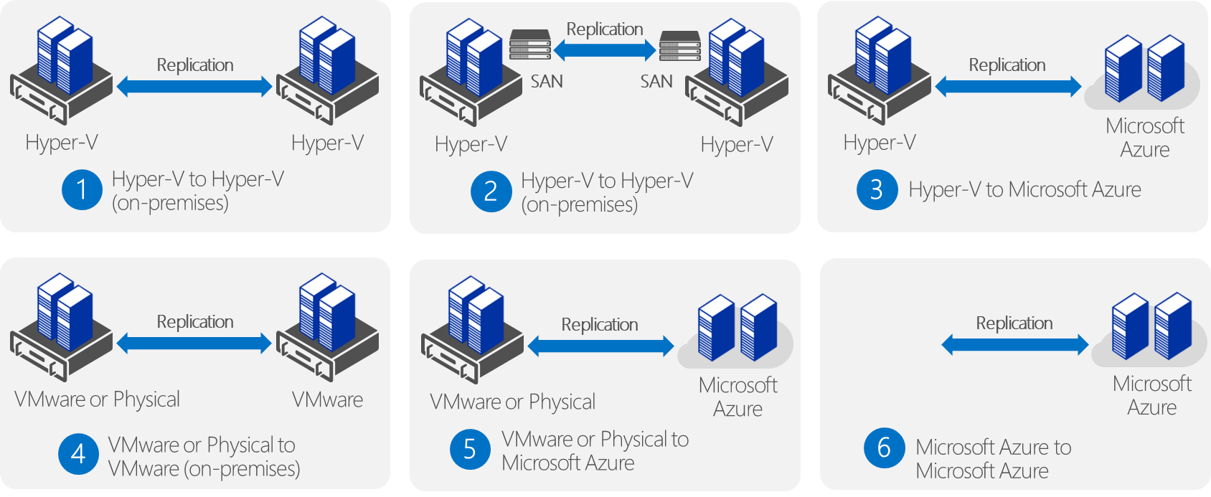
Azure Site Recovery Scenarios One solution for multiple infrastructures
Protect important applications by coordinating the replication and recovery of private clouds across sites. Protect your applications to your own second site, a hoster’s site, or even use Microsoft Azure as your disaster recovery site.

Slide 15
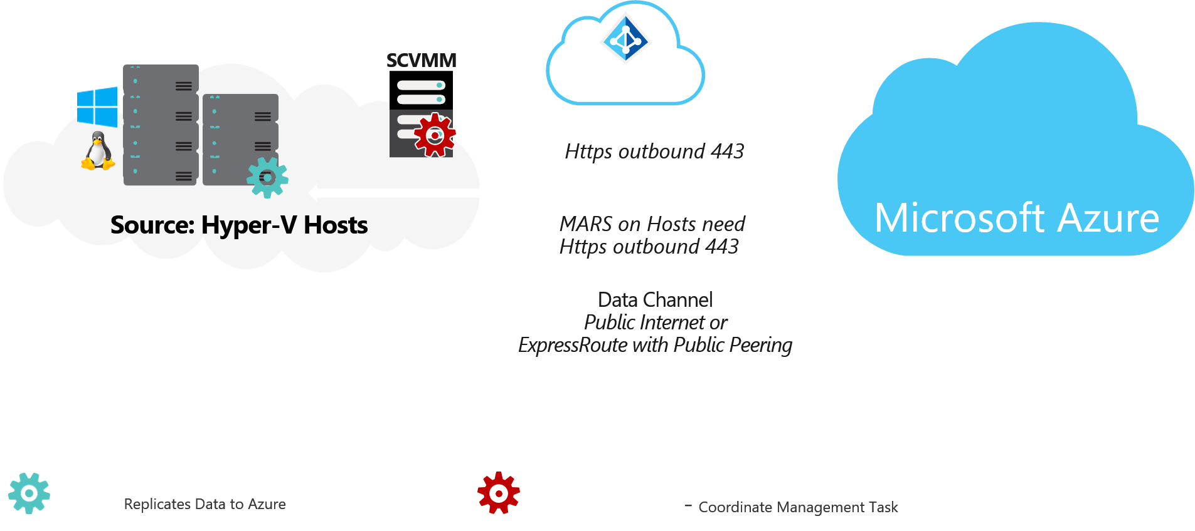
Recover Hyper- V VMs to Azure Architecture

Slide 16
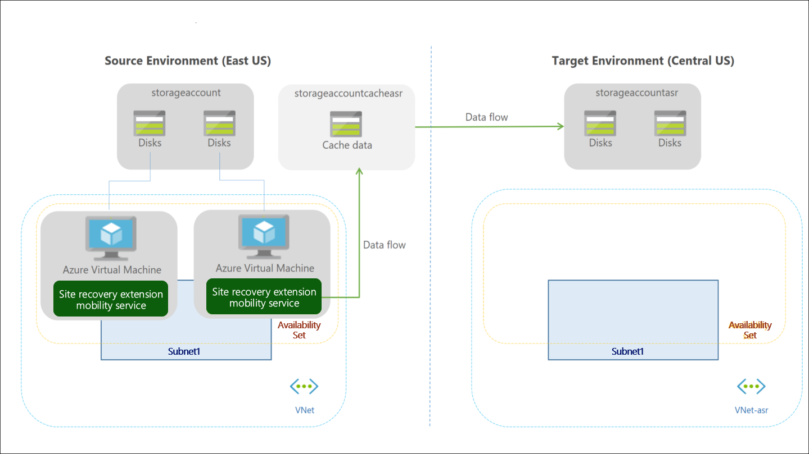
Common scenarios
Azure Site Recovery Region to Region Failover

Slide 17
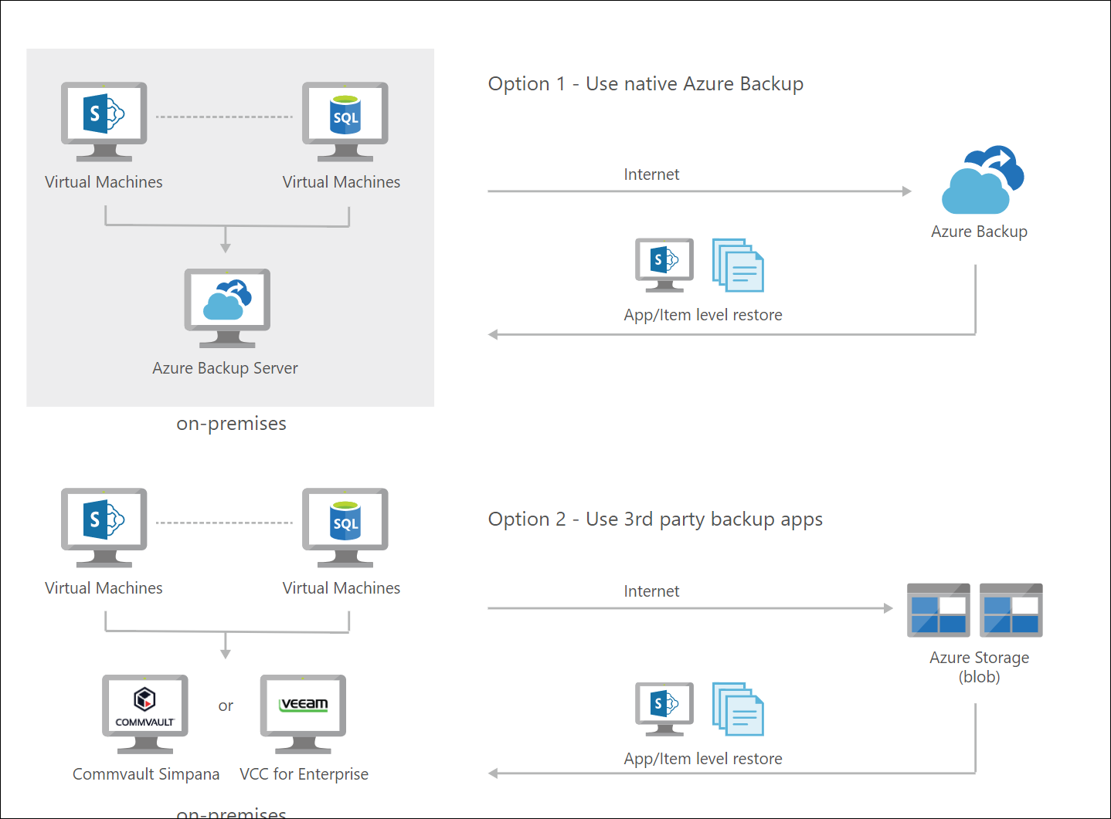
Common scenarios
Azure Backup
and
Third Party Back Solutions

Slide 18
Step 2: Design the solution
Outcome
Design a solution and prepare to present the solution to the target customer audience in a 15-minute chalk-talk format.
Timeframe
60 minutes
Business needs (10 minutes) | Respond to questions outlined in your guide and list the answers on a flipchart.
Design (35 minutes) | Design a solution for as many of the stated requirements as time allows. Show the solution on a flipchart.
Prepare (15 minutes) | Identify any customer needs that are not addressed with the proposed solution. Identify the benefits of your solution. Determine how you will respond to the customer’s objections. Prepare for a 15-minute presentation to the customer.

Slide 19
Step 3: Present the solution
Outcome
Present a solution to the target customer in a 15-minute chalk-talk format.
Timeframe
30 minutes (15 minutes for each team to present and receive feedback)
Directions
Pair with another table.
One table is the Microsoft team and the other table is the customer.
The Microsoft team presents their proposed solution to the customer.
The customer asks one of the objections from the list of objections in the case study.
The Microsoft team responds to the objection.
The customer team gives feedback to the Microsoft team.

Slide 20
Wrap-up
Outcome
Identify the preferred solution for the case study.
Identify solutions designed by other teams.
Timeframe
15 minutes

Slide 21
Preferred target audience
Naomi Sharp, VP of Datacenters
Adam Brooks, Directory of Continuity of Business (COB)
Database Architects / Administrators Management
Application Owners and Services Managers
Infrastructure, Virtualization, Storage and Networking Teams

Slide 22
Preferred solution
Azure Regions
North America: East US2, Central US
Europe: UK West, UK South
Australia: Australia East, Australia Southeast
These regions are closest to the locations of their current operations and datacenters.
Each of these regions are considered “Region Pairs”.
Miami, London and Sydney all support ExpressRoute, so this will be implemented along with the Premium SKU so all regions can see each other.

Slide 23
Preferred solution
Backup
Many third-party solutions are compatible using Azure as a DR target with installable solutions also available via the Azure Marketplace.
Customers to use extend their investment to the cloud and backup VMs that are running in Azure.
Move from tapes to the cloud for archive.
Deployments
IaaS: These deployments will be backed up using an Azure implementation of their third-party backup.
PaaS: Azure App Service and SQL Database have built in Backup services that must be implemented.
Robust solutions, but their features are dependent upon the select and SKUs that CI selects during the provisioning of these services.

Slide 24
Preferred solution
Disaster Recovery
Azure Site Recovery will be the primary BCDR Servers that is used for DR by CI.
The service will be used as a Migration Tool as well as a COB tool for failovers between either on-premise Hyper-V implementations or between two Azure Regions for IaaS deployments.

Slide 25
HA & BCDR solution: Workgroup Applications
Solution Overview
Azure Site Recovery will be used to migrate the VMs to Azure.
DR Implementation
Once VMs are in Azure IaaS, they will be setup for Azure Region to Region failover using ASR.
Backup
Third-party backup software implemented in Azure IaaS.

Slide 26
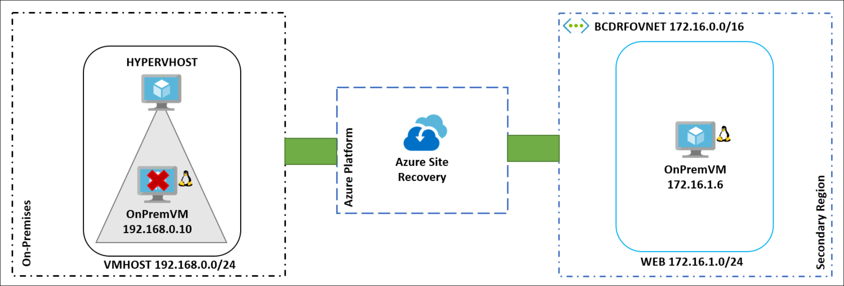
Work Group Applications
Preferred solution

Slide 27
HA & BCDR solution: Enterprise Applications
Solution Overview
Azure IaaS
Traffic Manager
ASR will be used to migrate the VMs to Azure and protect Region to Region.
For Applications remaining on-premises ASR will be used as a DR target with a failover and failback to Hyper-V.
Backup
Third-party backup software implemented in Azure IaaS.

Slide 28
HA & BCDR solution: Enterprise Applications - cont.
Region to Region Failover Implementation:
Migration to Azure be completed using a combination of Azure Site Recovery and SQL Always On Availability Groups.
First the AOG will be extended to have Asynchronous replicas running in an Azure Virtual Network over the ExpressRoute Circuit.
During the Failover for the migration the Asynchronous side of the AOG will be made a Synchronous replica and then a planned failover will make one of the Azure nodes the primary replica.
Once this is completed then ASR will be used to failover the Web tier to Azure and migration completed using the Azure portal.
Once migrated to Azure, the application will be re-protected to failover to the region pair that is assigned to their area of the world.

Slide 29
HA & BCDR solution: Enterprise Applications - cont.
Azure Automation
Runbooks will need to be written to support these failovers as they are complex and must be done in the proper sequence.
Using Runbooks will allow for single click failovers in both direction and won’t involve any manual steps.
IaaS Configurations
Managed Disks, Availability Sets and Premium disks
99.95% SLA
Internal Load balancer will also be used in front of the SQL Always On nodes that are running in Azure.
Traffic Manager
Priority traffic-routing method

Slide 30
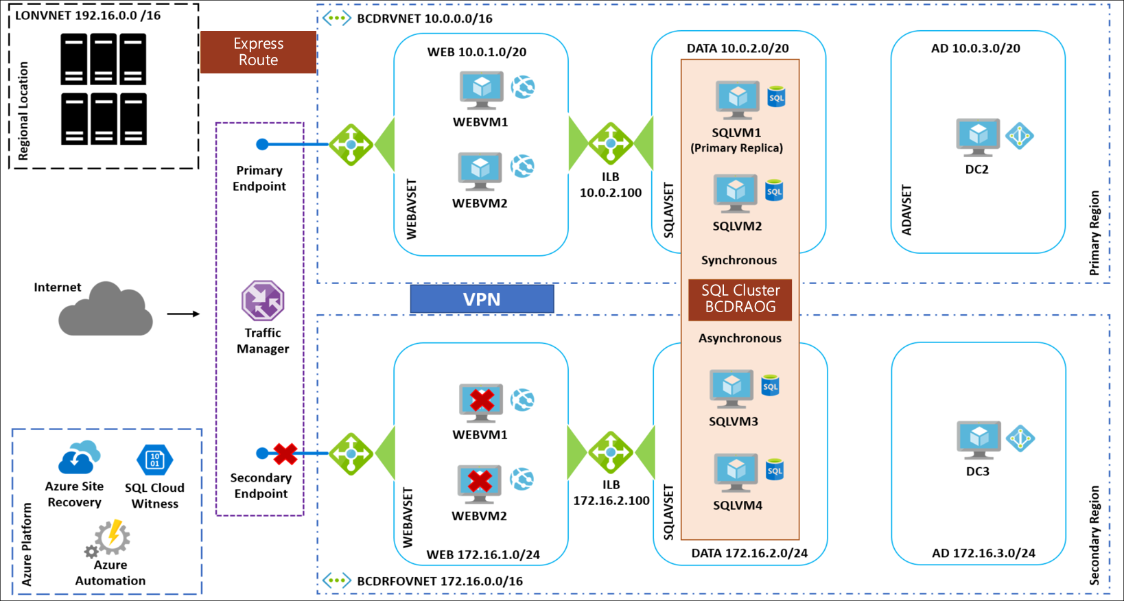

HA & BCDR solution: Enterprise Applications Azure Region to Region

Slide 31
HA & BCDR solution: Enterprise Applications - cont.
On-premises to Azure Implementation:
AOG will be extended to have Asynchronous replicas running in an Azure Virtual Network over the ExpressRoute Circuit.
Azure Site Recovery will then be configured for a forced failover which will make one of the Asynchronous nodes in Azure a Synchronous replica and the primary replica.
ASR will be used to failover the Web tier to Azure.
Once the outage on-premises has been resolved and the SQL nodes are back online in the local datacenter a planned failover back using ASR will be executed.
First resuming data movement on the local nodes and once synchronized then a planned failover using ASR will assign a new primary replica locally and fail back the web tier.

Slide 32
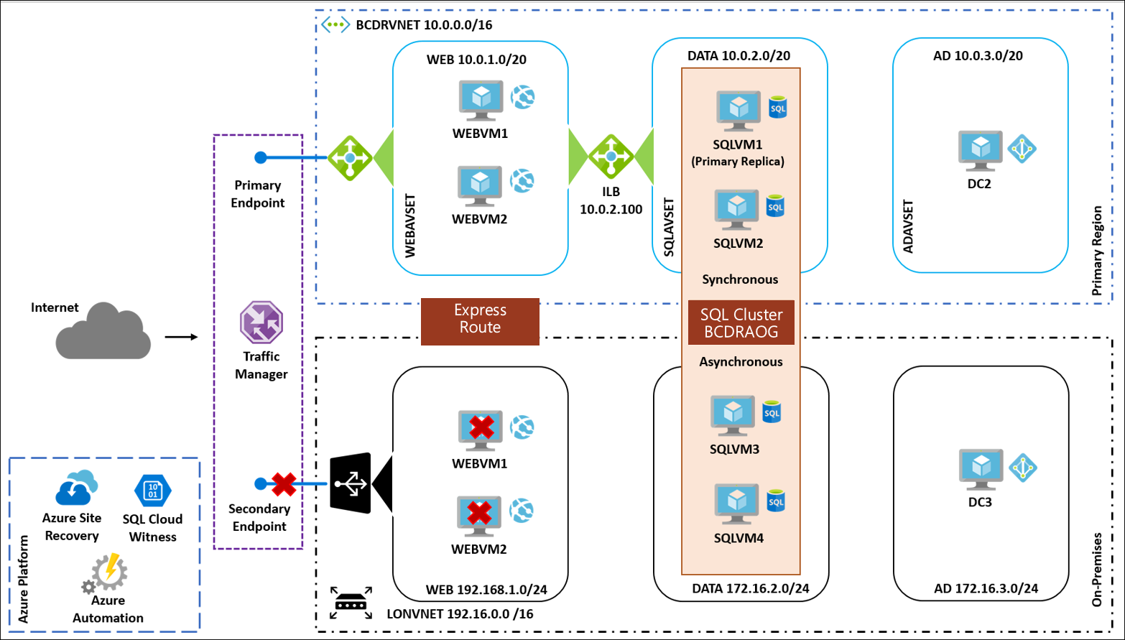
HA & BCDR solution: Enterprise Applications On-premises to Azure
Express Route
SQL Cluster BCDRAOG
DC1
DATA 192.168.2.0/24
AD 192.168.3.0/24

Slide 33
HA & BCDR solution: Global, Mobile, API Applications
Solution Overview
Azure App Services
SQL Database
Traffic Manager
Application Deployment
Multiple points of presence for these applications will be deployed in the Azure Regions.
Given the nature of their business there will always be at least two POPs per region.
Autoscaling will also be leveraged to ensure that the site can deal with traffic spikes.

Slide 34
HA & BCDR solution: Global, Mobile, API Apps – cont.
SQL Database
The SQL Database will be implemented using Failover Groups.
Allows for geo-replication with a single listener name like the SQL Always On Availability Groups.
Simplifies issues of connection strings within the App Services Application Settings.
By pointing at the Listener rather than a server there should never be an issue if a Database is failed over.
Azure Automation
Leveraged for custom configuration changes during a failure.
Runbooks triggered by a webhook could fire when there is a failure.
CI/CD Tools also could be implemented for deployments or testing.

Slide 35
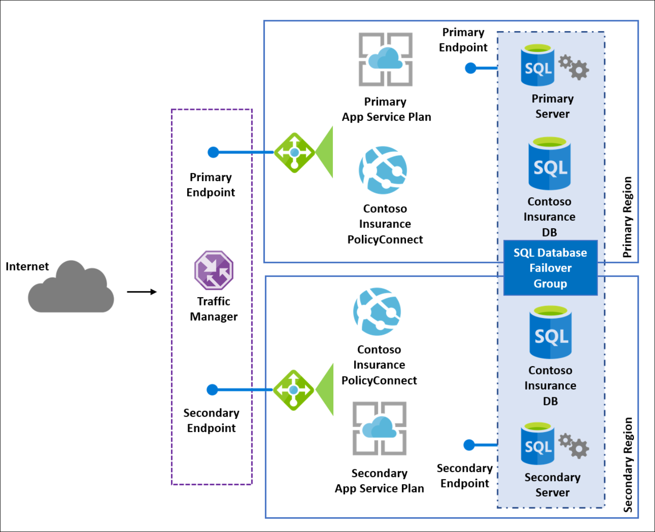
HA & BCDR solution: Global, Mobile API Applications

Slide 36
Preferred objections handling
With the move to the cloud, they are uncomfortable with any situation that assumes the cloud provider will handle their fail-over.
Potential Answer
Using ASR CI will be able to handle all of their own DR. They will be using familiar tools with the Azure Portal and Hyper-V.

Slide 37
Preferred objections handling
They have many systems that need to be accounted for and they aren’t sure if the tools really exist to give them the business continuity they desire.
Potential Answer
There are BCDR tools built into the all of the different application classification they have at CI, including Linux.

Slide 38
Preferred objections handling
They want to know their BCDR solution is secure.
Potential Answer
All of the traffic and data used for all Azure BCDR features is secured both at rest and in-transit. As a result there is no difference in this data and any other data that is running or stored in Azure.

Slide 39
Preferred objections handling
They have heavily invested in a third-party backup solution but want to use Azure as their archive. Does Azure support this?
Potential Answer
Azure has support for third party backup providers through the Azure Marketplace. It’s possible to both backup VMs using these tools by deploying them to Azure IaaS or by extending the backup infrastructure to use the Azure cloud as an archive target.

Slide 40
Customer quote
“Azure has BCDR built into each classification of application that we have here at Contoso Insurance. This depth and breadth will allow us to meet both our business needs and regulatory requirements for our applications. Not to mention ensuring our agents are able to help our customers in their time of need.”
- Liz Simmons– VP of Datacenters

